Slide 1
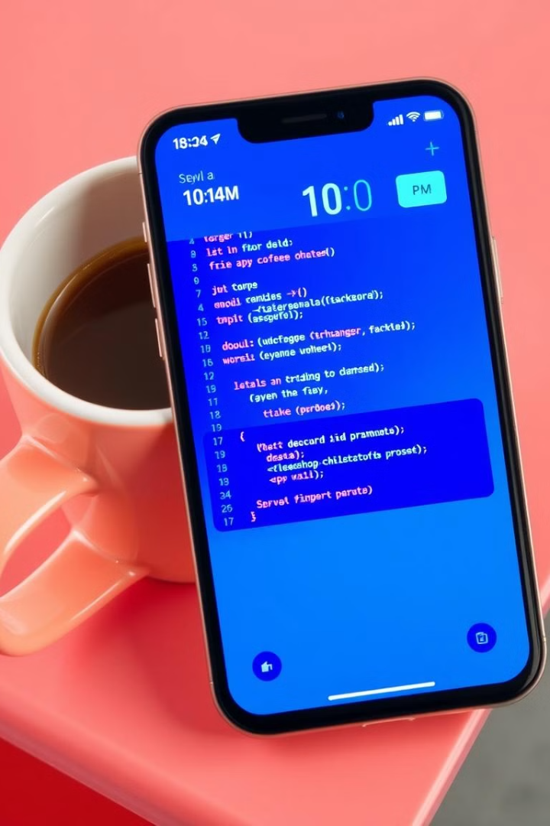

TECHTONIC
Your Gateway to Programming Mastery.

Slide 2

Aims of Project
1
easy-to-use application
Make programming accessible to everyone, teach programming to beginners and professionals.
2
support several programming languages
customizing educational paths based on the user level by providing interactive content, practical lessons.
3
Foster a Love for Coding
Make learning to code a rewarding and enjoyable experience.

Slide 3
Problem Statement
Many beginners struggle with learning programming due to scattered resources,
lack of structured guidance, and limited interactivity.
Existing platforms often cater to specific levels or require prior knowledge,
which makes it hard for complete beginners to keep up.
There’s also a lack of personalization in most platforms.
Our project aims to solve these issues by providing an accessible, structured,
and interactive learning experience tailored to each user’s level.

Slide 4
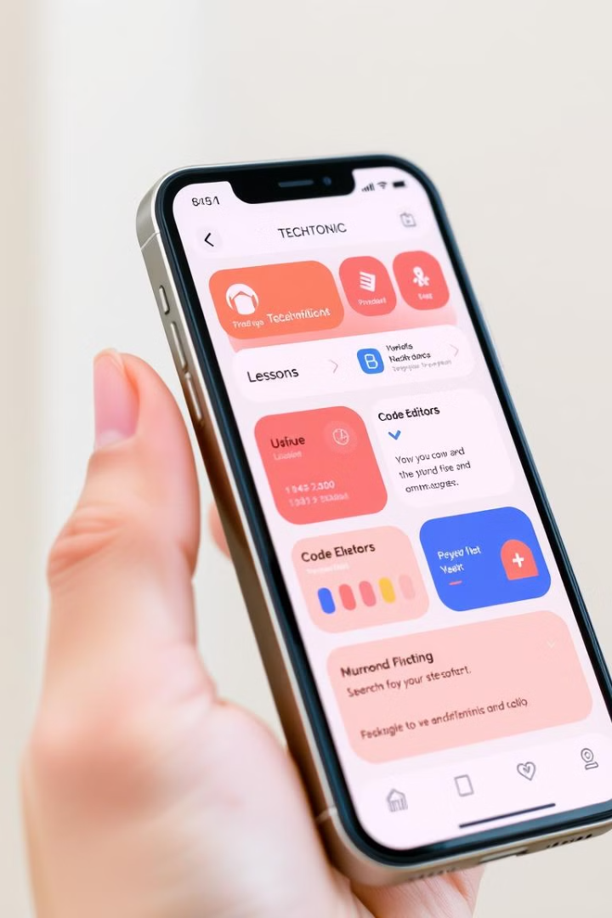
Basic characteristics of the application:
User-Friendly Interface
Registration and Login
Simple and intuitive design, easy to navigate, with clear instructions.
Sign up with email or via Google.
Organize the division of content
Track progress
Divide the content into multiple levels such as "beginner", "intermediate", and "professional", and then divide these levels into different tracks.
A system to track the progress of users in lessons with saving the location of the stop and resumption of learning with the display of the completion rate of each learning track.
Notification System
Integration with Backend
Send notifications to users to remind them to follow the lessons. Notifications when new content is added.
APIs for fetching lessons and content (which are stored in a database).
A system for managing users .

Slide 5

Features of application
A structured course catalog with search and filtering
Track user progress through courses, completed lessons, and scores.
Provide certificates after course completion.
Allow users to purchase courses via in-app payments or subscription models.
An in-app code editor that allows users to write, run, and debug code in multiple languages (Python, JavaScript, Java, etc.

Slide 6




















Comparison with other applications
APP Name
Icon
Track progress
interactive content, practical lessons
free content
offline access
Road map
compiler
Sololearn
Code academy
Udemy
Coursera
TechTonic

Slide 7
Competitor Comparison & Our Unique Value
We analyzed apps like Sololearn, Codecademy, Udemy, and Coursera.
While they offer valuable content, most either require payment for full access
or lack an integrated practice environment.
Our app TechTonic combines key features:
- Free access to basic content
- Built-in compiler for practicing directly in the app
- Clear roadmaps and progress tracking
- Offline access and multi-language UI
Our unique value lies in combining learning paths, interactivity, and practical tools,
all within one seamless, beginner-friendly experience.

Slide 8
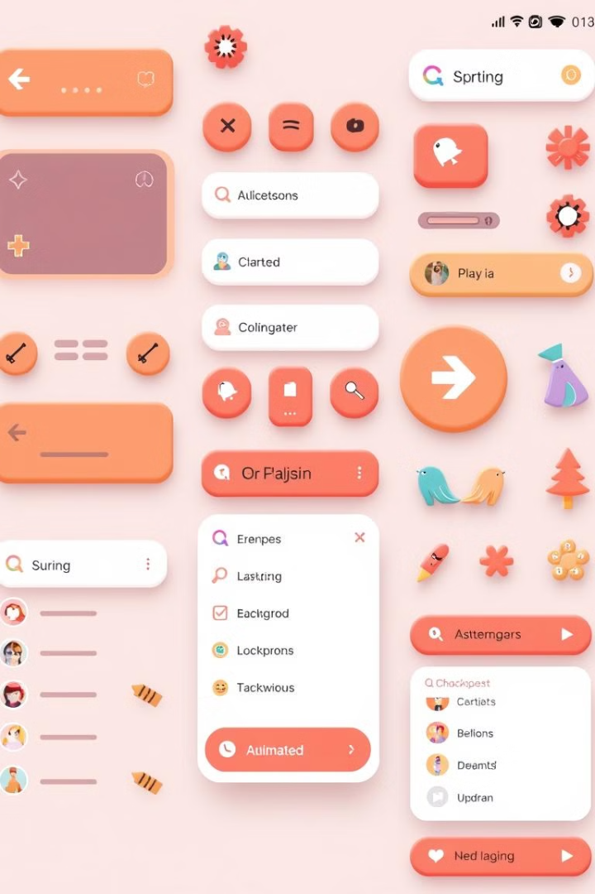





Frontend (Flutter) Skills and Tools
Flutter
Dart
Cross-platform framework for building native-like mobile apps.
Object-oriented programming language used in Flutter.
Widgets
State Management
Reusable UI elements that form the building blocks of Flutter apps.
Techniques for managing and updating the state of the app.(e.g., Provider, Bloc)
Responsiveness
Learn how to make the app responsive to different screen sizes.

Slide 9





Backend skills and tools
Cloud Services
Platforms like Render to host the backend infrastructure.
Databases
Using mongoDB for
Storing and managing user data, learning progress, and app settings.
API Development
Building interfaces for communication between the frontend and backend.
Authentication and Authorization
Securing user accounts and controlling access to app resources.

Slide 10

Common skills and tools
Integrated Development Environments (IDEs): VS Code, Android Studio.
Cloud storage: Use Firebase Storage or Cloudairy to store large files such as videos or lesson photos.
Notices: Push Notifications integration using Firebase or other tools such as OneSignal.
Communication Tools: Zoom and Discord .
Version Control Systems: GitHub.

Slide 11

Behavioral and Structural Views
• ACTIVITY DIAGRAM
• USE CASE DIAGRAM

Slide 12
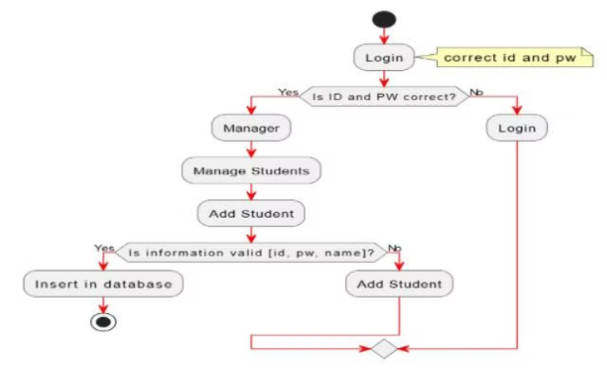
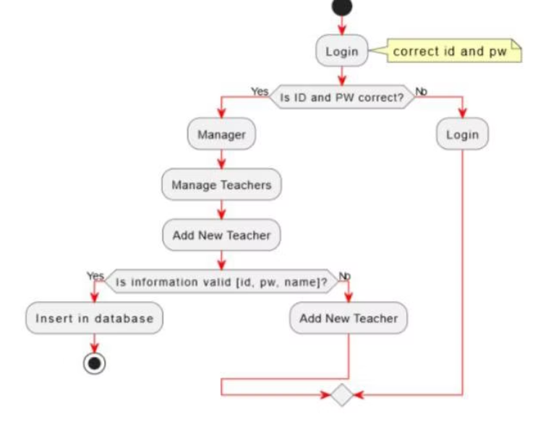
Activity Diagram
Represents the flow of control or object flow with an emphasis on the sequence and conditions of the flow.
Activity Diagram of Manger adds New Student
Activity Diagram of Manger adds New Teacher

Slide 13
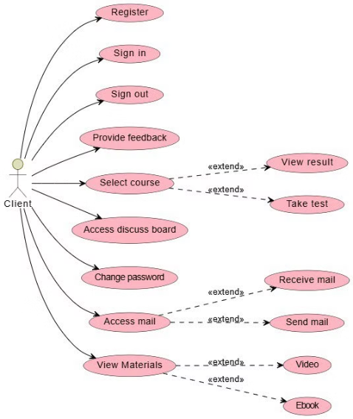
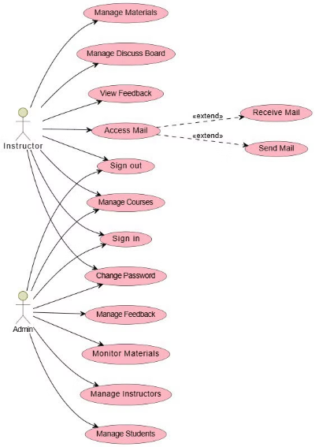
USE CASE DIAGRAMS
A use case is a written description of how users will perform tasks on the app. It outlines, from a user’s point of view, a system’s behavior as it responds to a request. Each use case is represented as a sequence of simple steps, beginning with a user's goal and ending when that goal is fulfilled
Client Use Case Diagram
Admin Use Case Diagram

Slide 14
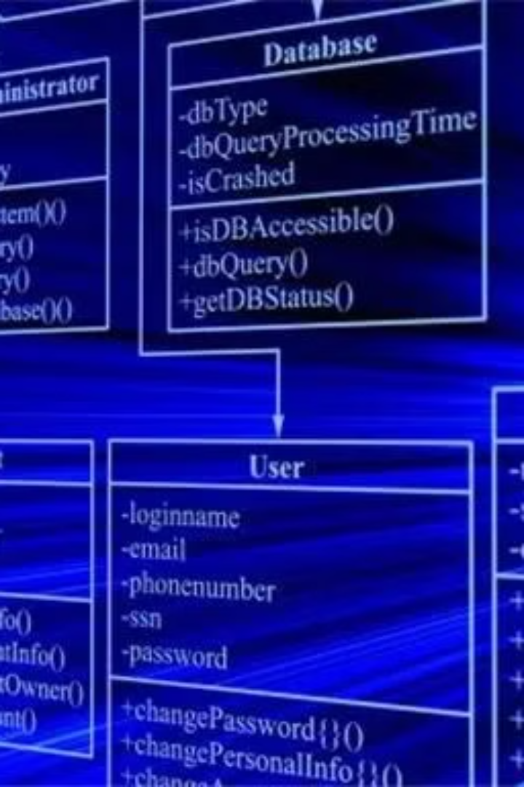
DATABASE DESIGN
CLASS DIAGRAM
ENTITY RELATIONSHIP DIAGRAM

Slide 15
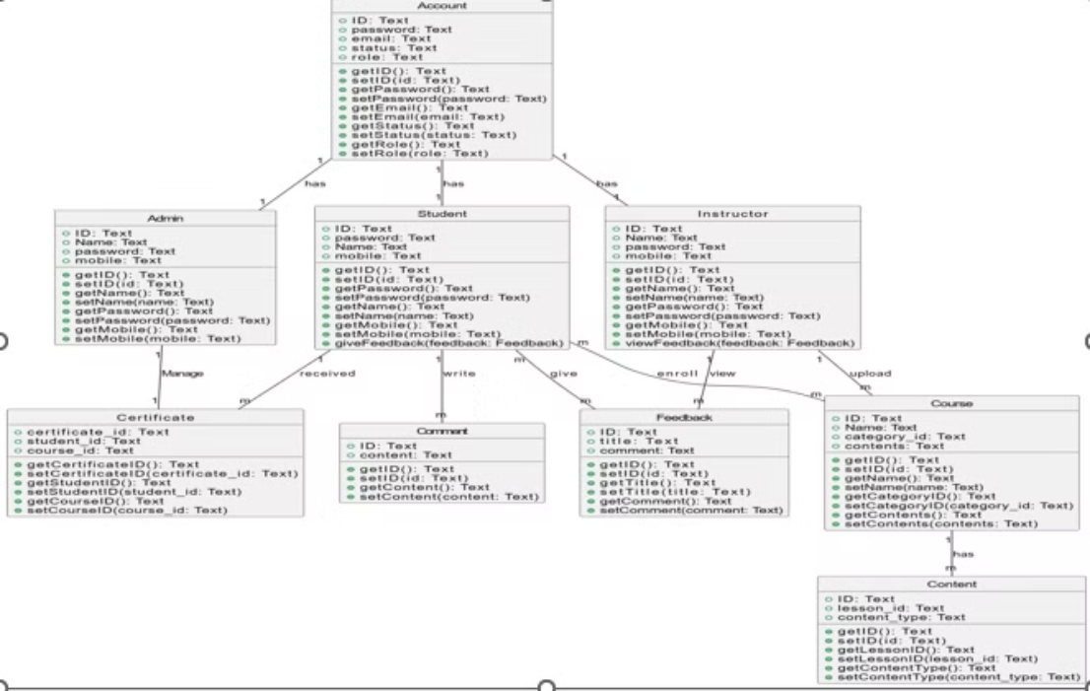
Class Diagram
UML structure diagram, which shows structure of the designed system at the level of classes and interfaces, shows their features, constraints and relationships -associations, generalizations, dependencies, etc.

Slide 16
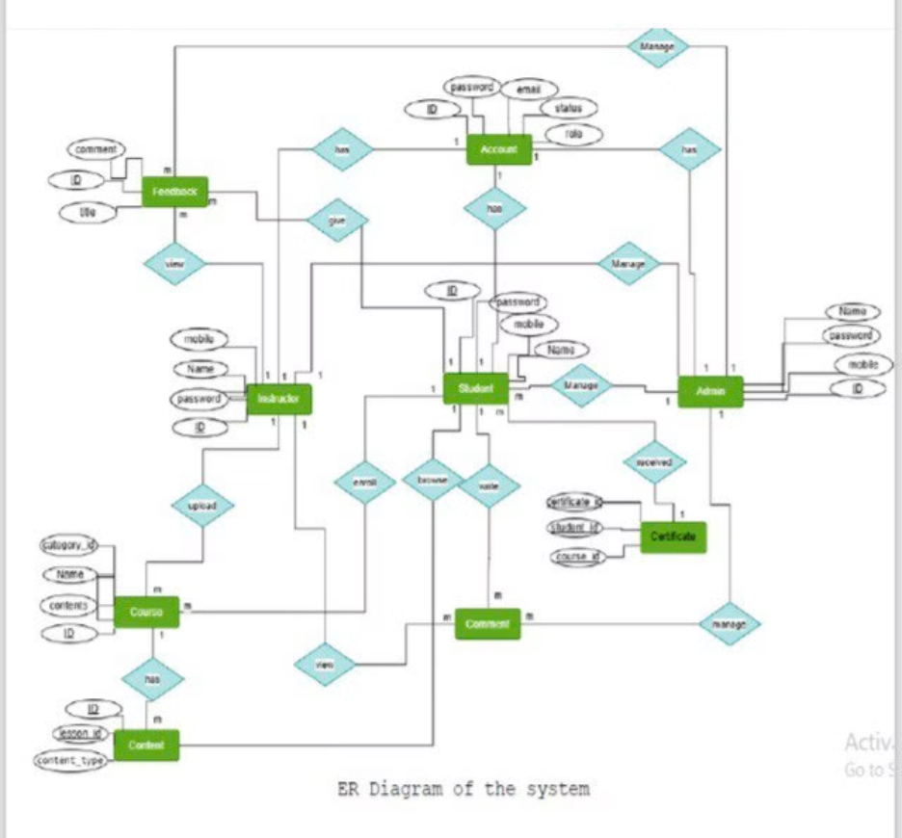
ER Diagram

Slide 17
High-Level Use Cases
• User Registration & Login: Sign up using email or Google.
• Track Selection: Choose skill level and preferred track.
• Lesson Access: View videos, read content, or solve exercises.
• In-App Coding: Practice code directly using the built-in compiler.
• Progress Tracking: Track completion rates and resume from last lesson.
• Certificates: Receive a certificate upon course completion.
• Discussion Forums: Engage with community and ask questions.

Slide 18
Challenges & Lessons Learned
• Time Management: Overcame by using task boards and regular meetings.
• Technical Integration: Improved skills in API development and debugging.
• Design Alignment: Learned importance of prototyping and consistency.
• Key Lesson: Communication and planning are essential alongside coding.

Slide 19
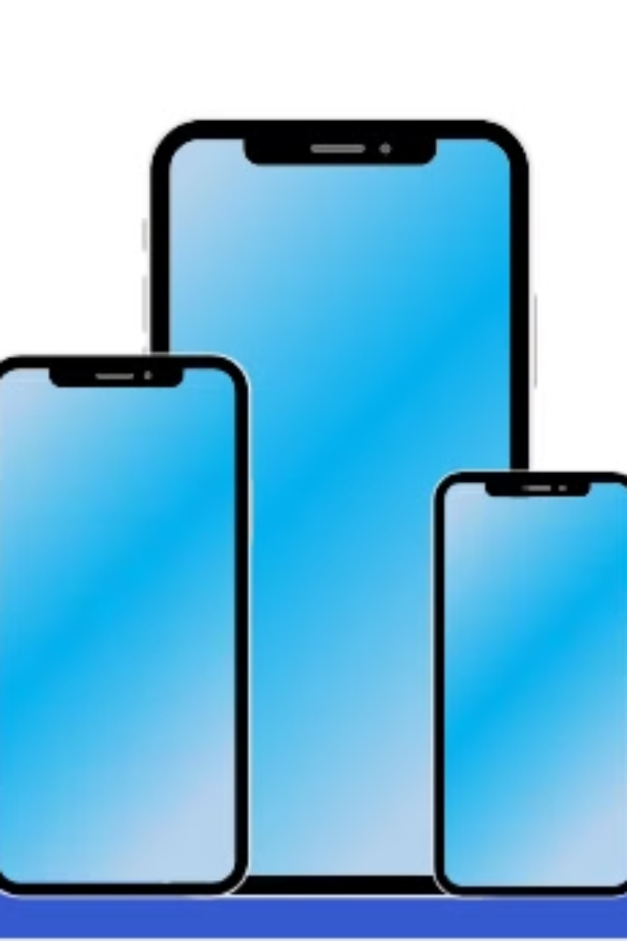
INTERFACES OF APPLICATION

Slide 20

Splash Screen

Slide 21
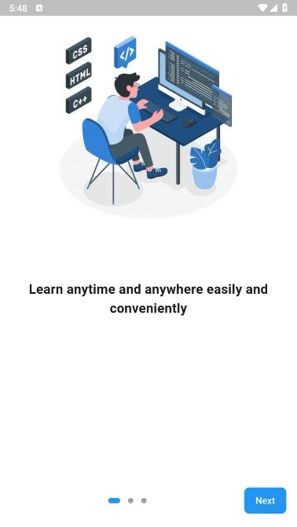
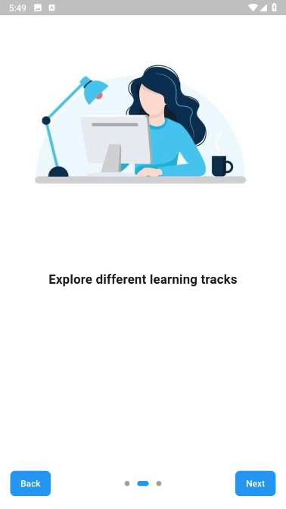
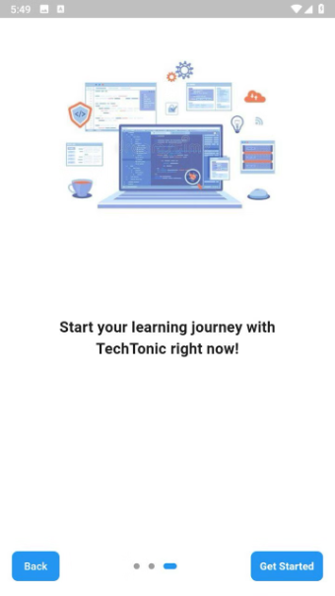
On boarding Screen

Slide 22
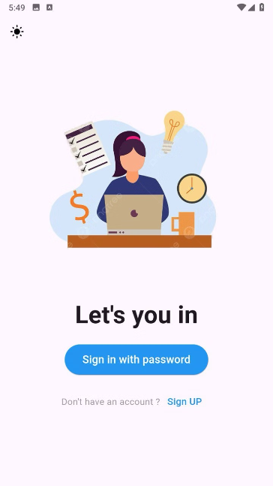
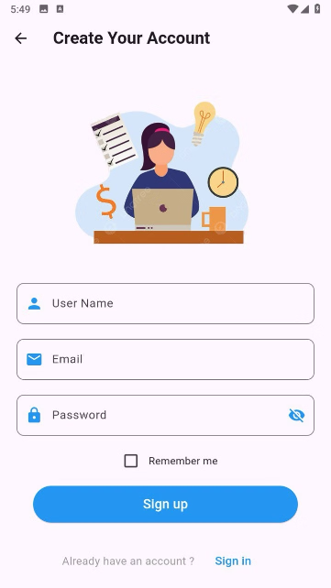
Start Screen
Create Screen

Slide 23
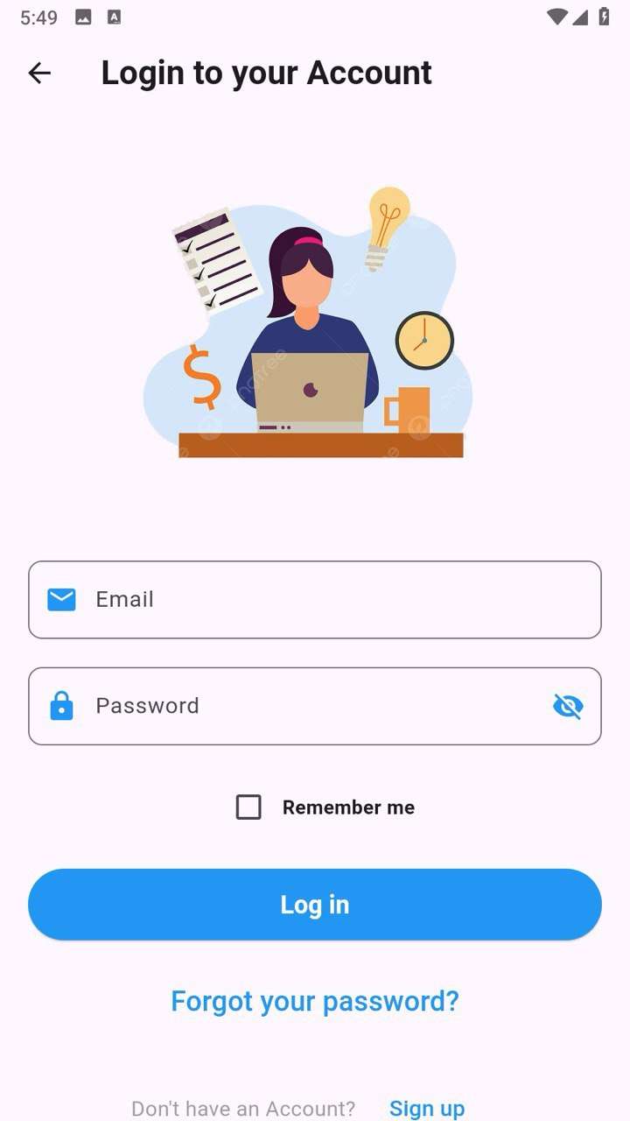
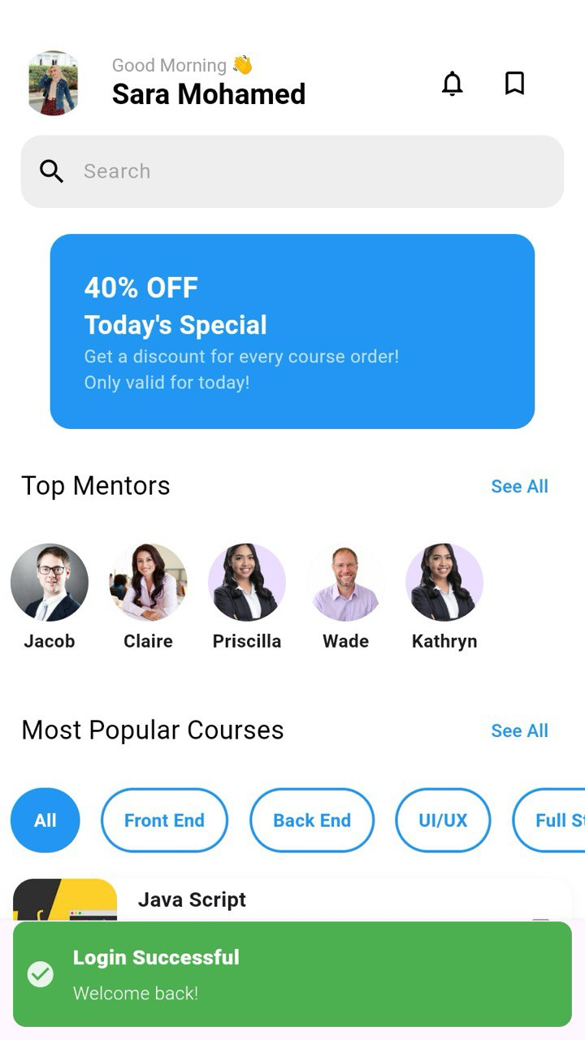
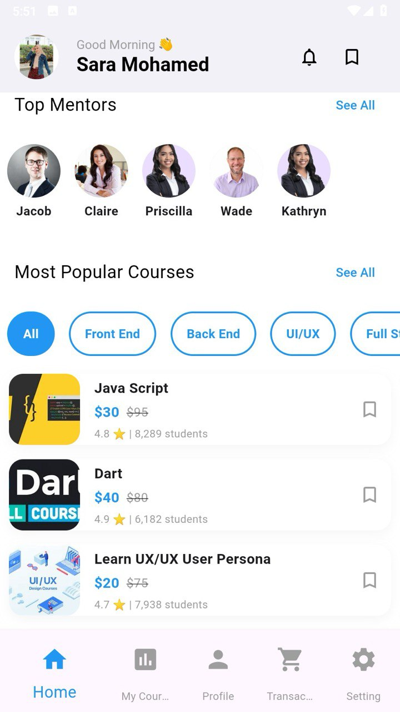
Login Screen
Home Screen
Home Screen

Slide 24
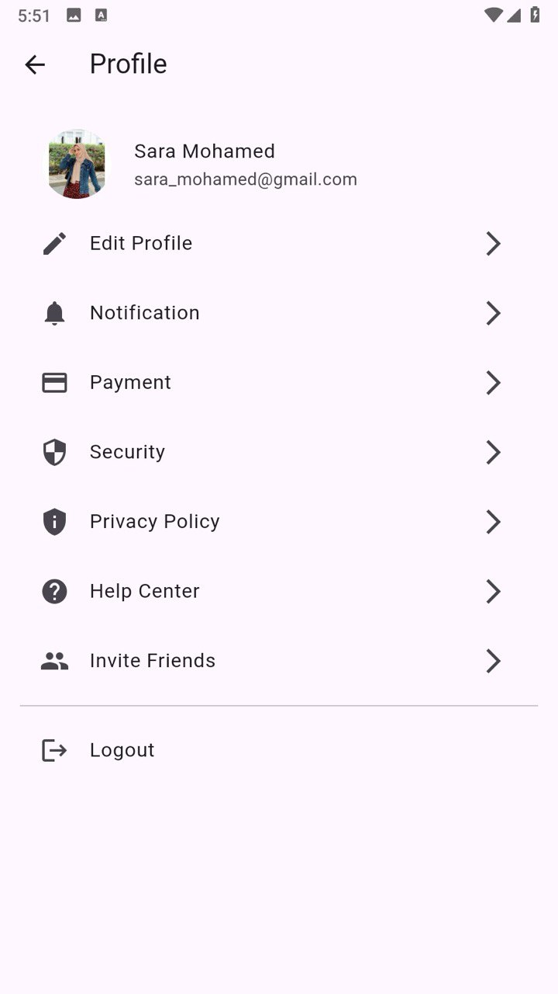
profile Screen

Slide 25
Team Contributions
• Fares Ayman Khalil:
Role: Team Lead & Backend Developer
Email: faressaymann@gmail.com
Bio: Passionate about coding and crafting smooth,
reliable backend systems that make learning easy and fun.
• Hasnaa Hesham Kassab:
Role: Flutter Developer
Email: member4@example.com
Bio: Designs responsive Flutter UI and connects frontend with backend.

Slide 26
• Sara Mohamed Eisa
Role: Flutter Developer
Email: member3@example.com
Bio: Specialized in Flutter app navigation and state management.
• Mohamed Said
Role: Flutter Developer
Email: member2@example.com
Bio: Handles API integration and frontend testing in Flutter.

Slide 27

Our Team
Fares Ayman Khalil
Hasnaa Hesham Kassab
Sara Mohamed Eisa
Mohamed Sayed Hassan
Supervised by :
Dr: Ghada Nour El-din Ahmed

